Slide 1


Slide 2




Slide 3
  “For the mouth speaks
  what the heart is full of.

Slide 4
  A good man brings good things
  out of the good stored up in him,
  and an evil man brings evil things
  out of the evil stored up in him.

Slide 5
  But I tell you that everyone will have to give
  account on the day of judgment for every
  empty word they have spoken.

Slide 6
  For by your words you will be acquitted,
  and by your words you will be condemned.”
  Matthew 12:34-37 NIV

Slide 7
  “Likewise, the tongue is a small part
  of the body, but it makes great boasts.
  Consider what a great forest is set on fire
  by a small spark.” James 3:5 NIV

Slide 8
  “Do not let any unwholesome talk come out
  of your mouth, but only that which is helpful for building others up according to their needs, that it may benefit those that listen.” Ephesians 4:29

Slide 9



Slide 10
  First we must desire to spend time
  with one another.

Slide 11
  Second we must understand that the conversation
  that we are having may not be about us.

Slide 12
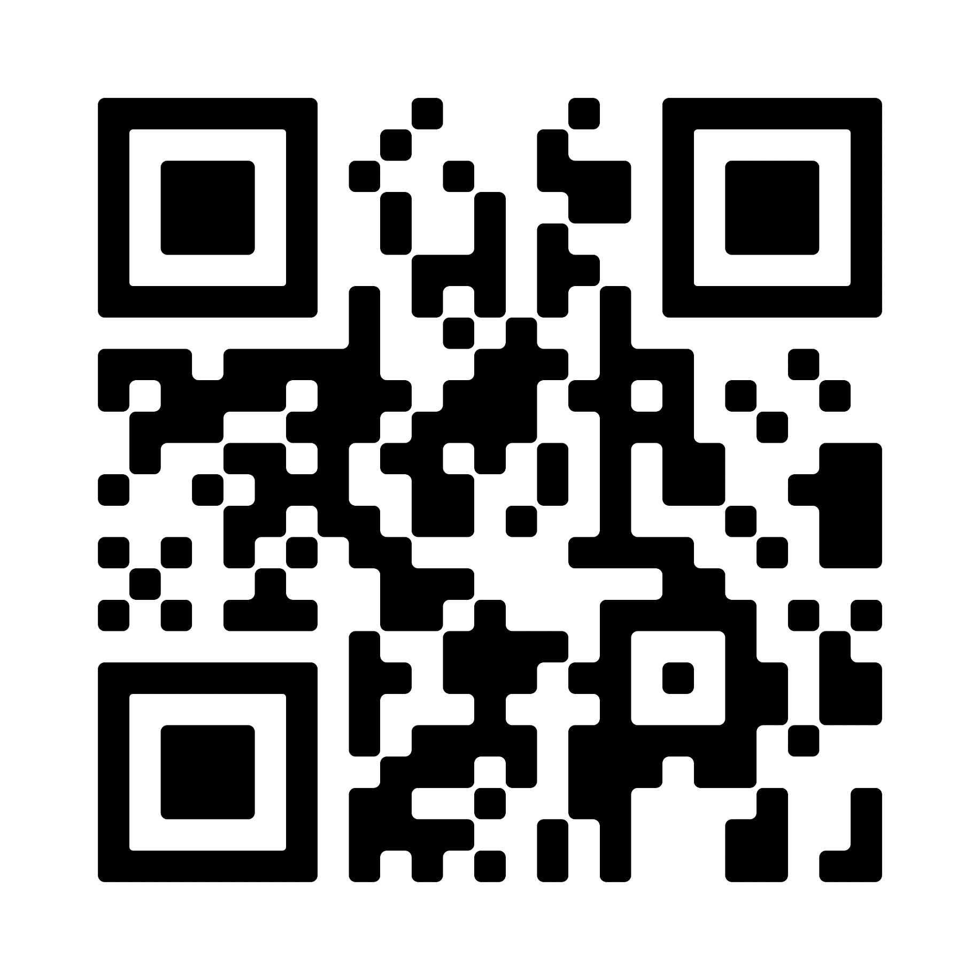

  Join a Southside Group today!
  southsidechurchva.org/groups

Slide 13


